Slide 1


Project: E-Commerce Device Tech Store
PROFESSIONAL PROGRAMMING
TRAINING CENTER
IVIETTECH
Instructors: Huỳnh Quang Vinh
Project team: Nguyễn Võ Hoàng Long
Đà Nẵng, ngày 3 tháng 1 năm 2022

Slide 2

Introduce

Slide 3
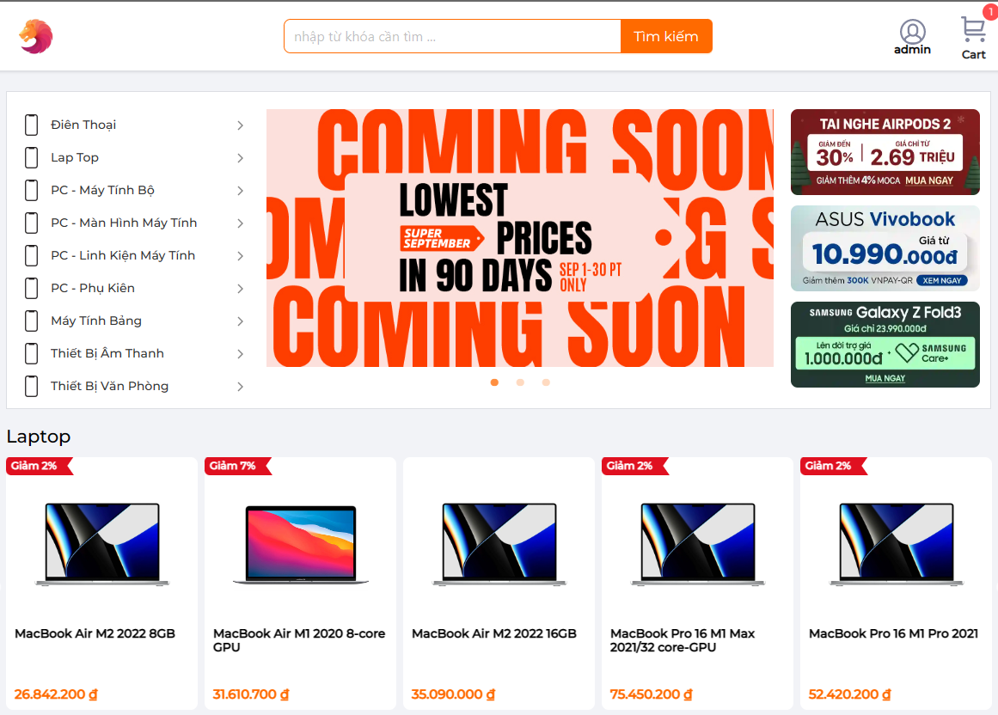
Project Introduction
Project Introduction
Project Device Tech is an E-Commerce website to provide services for sellers and customers to buy and sell technology devices easily.

Slide 4





Technical Stacks

Slide 5
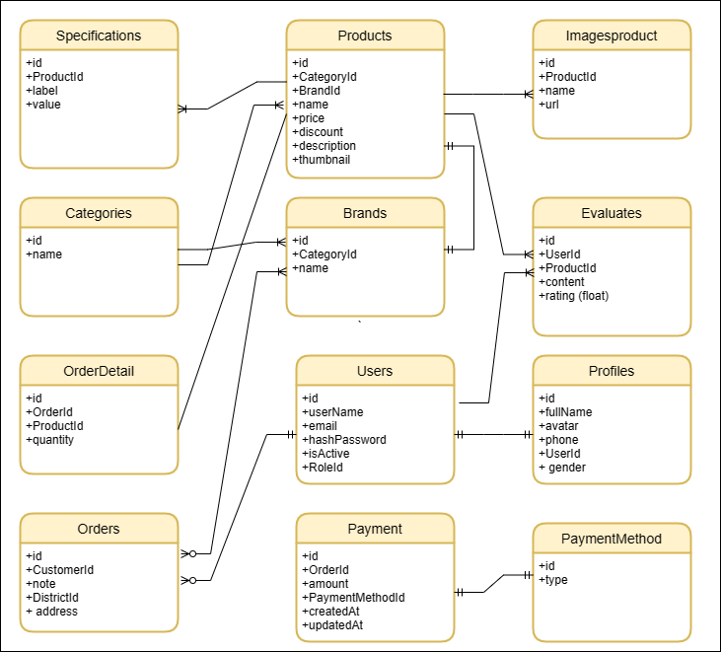
Entity Relationship Diagram

Slide 6
E-Commerce Introduction
Product Features
Customer side
Registration
Change avatar
Login
Session Customer
Logout
Logout
Change password
Forgot password

Slide 7
E-Commerce Introduction
Product Features
Customer side
View Product
Search Product
View Orders
Shopping Customer
Checkout
View product detail
Update cart
Add to cart

Slide 8
E-Comerce Introduction
Product Features
Administration side:
Manage Customers
Manage Products
Login
Admin
Logout
Manage Categories
Manage Orders

Slide 9
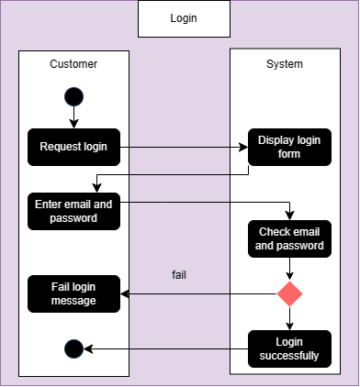
Behavior - Customers
Login

Slide 10
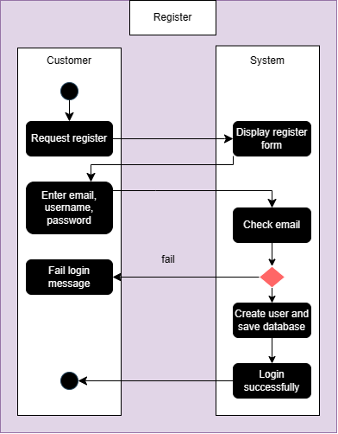
Behavior - Customers
Register

Slide 11
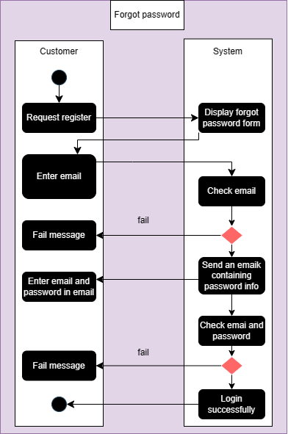
Behavior - Customers
Forgot password and reset pasword

Slide 12
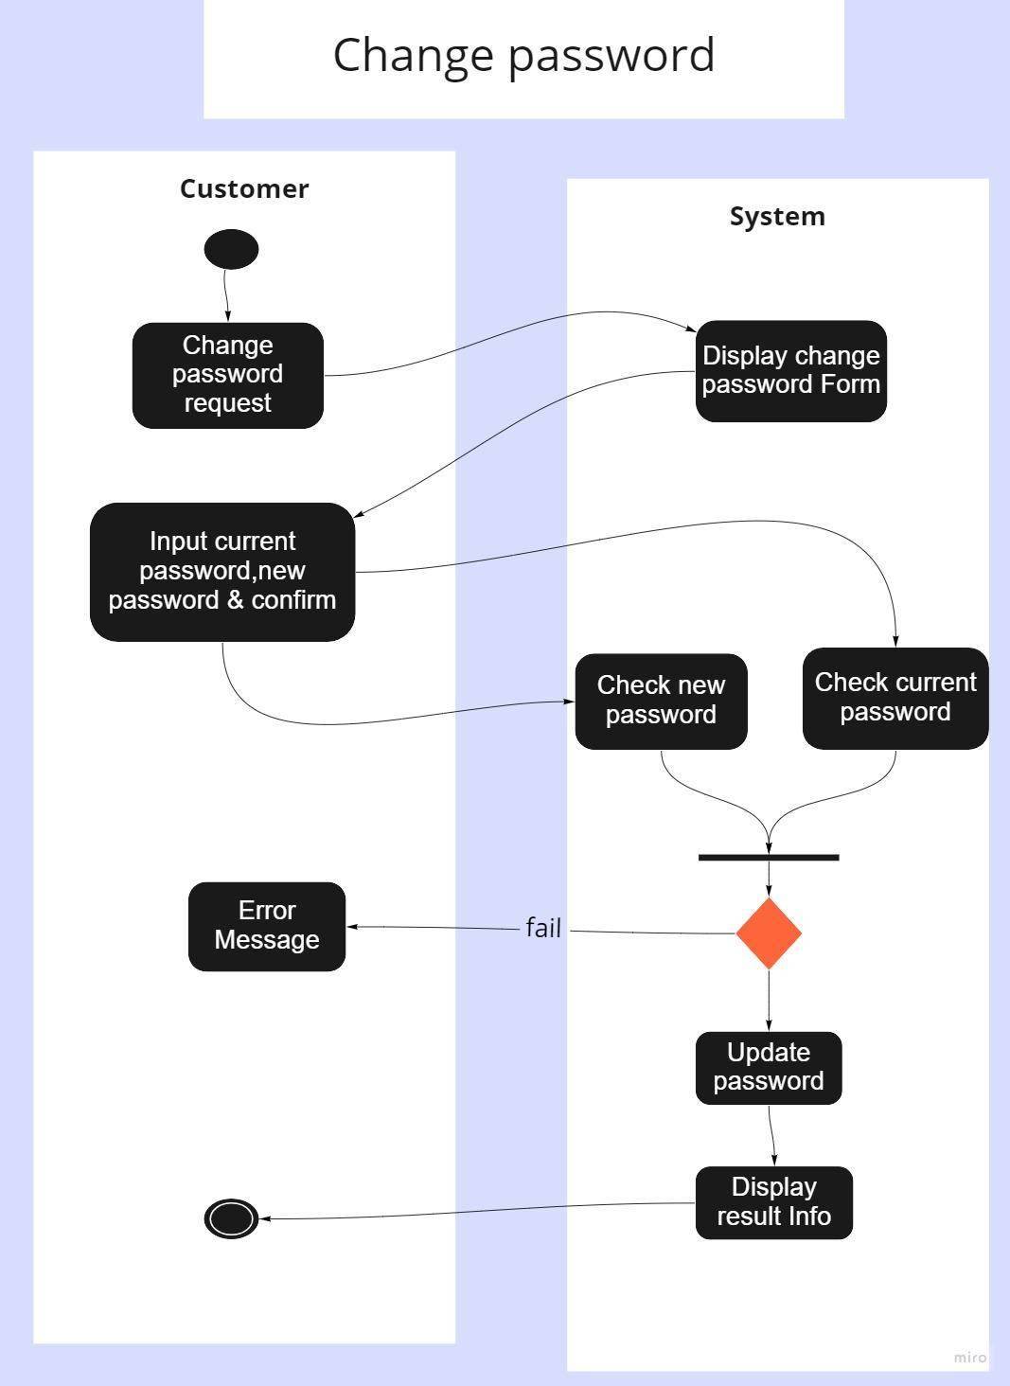
Behavior - Customers
Change Password

Slide 13
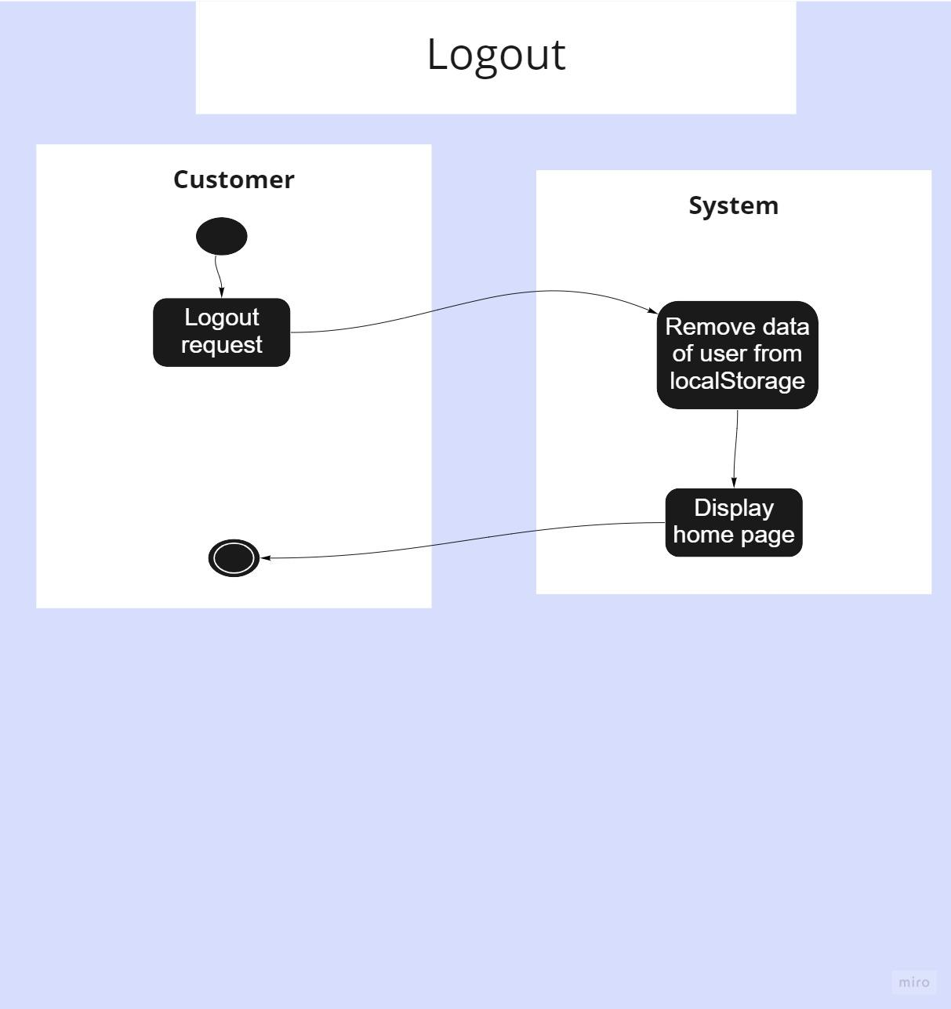
Behavior - Customers
Logout

Slide 14
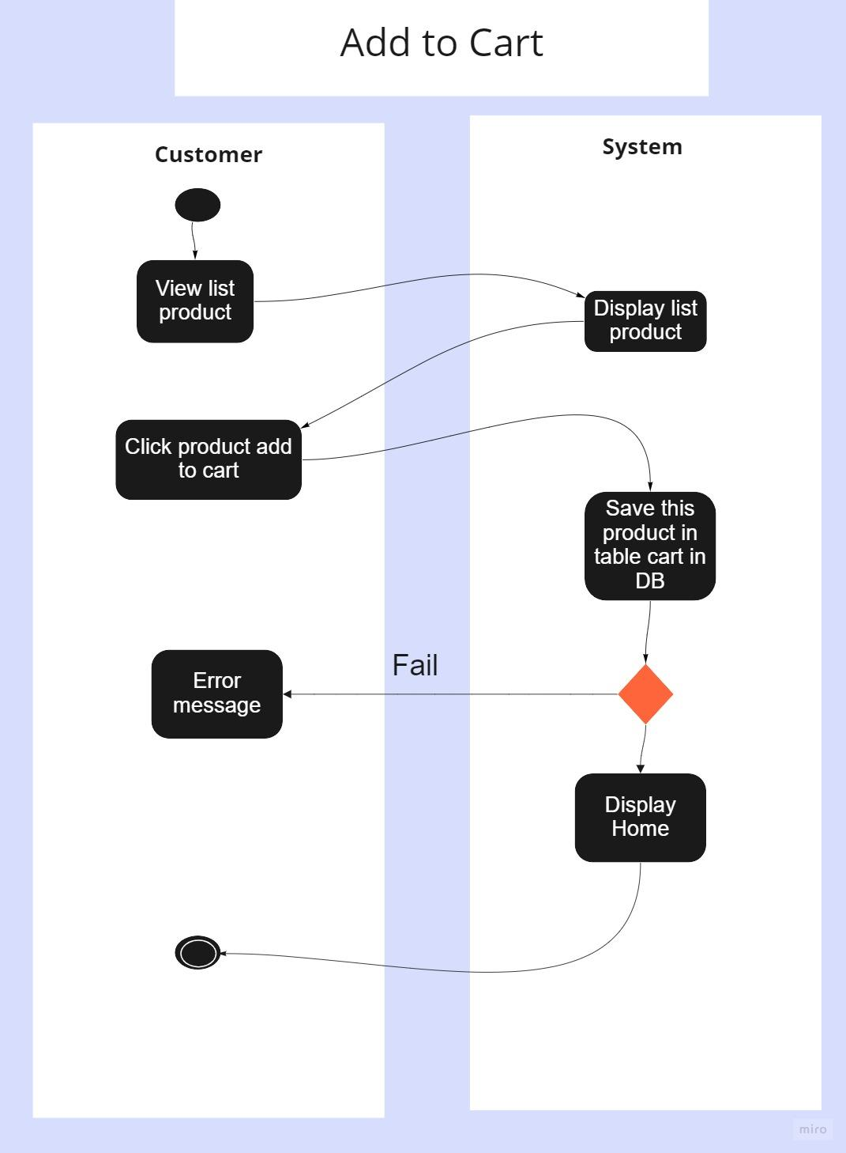
Behavior - Customers
Add to cart

Slide 15
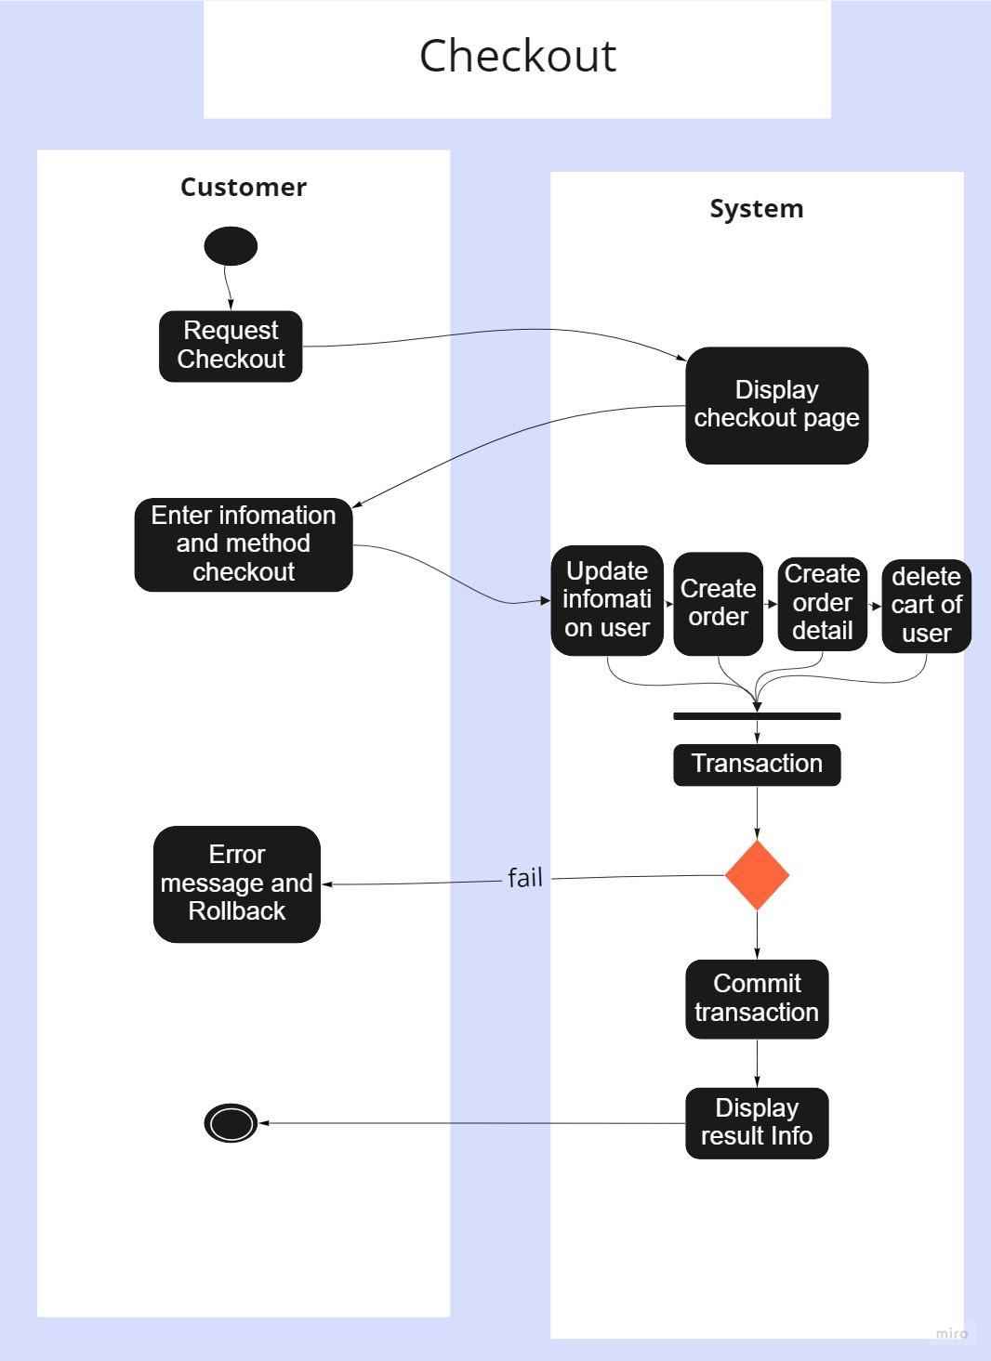
Behavior - Customers
Checkout

Slide 16
UI Design
Customer-side
Home page interface.

Slide 17
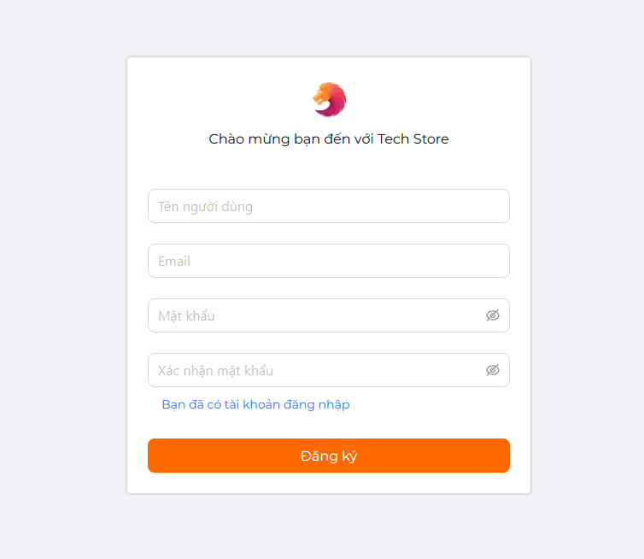
UI Design
Customer-side
Resgister account :

Slide 18
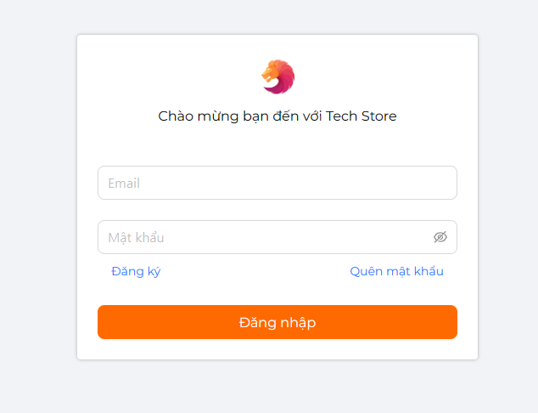
UI Design
Customer-side
Login:

Slide 19
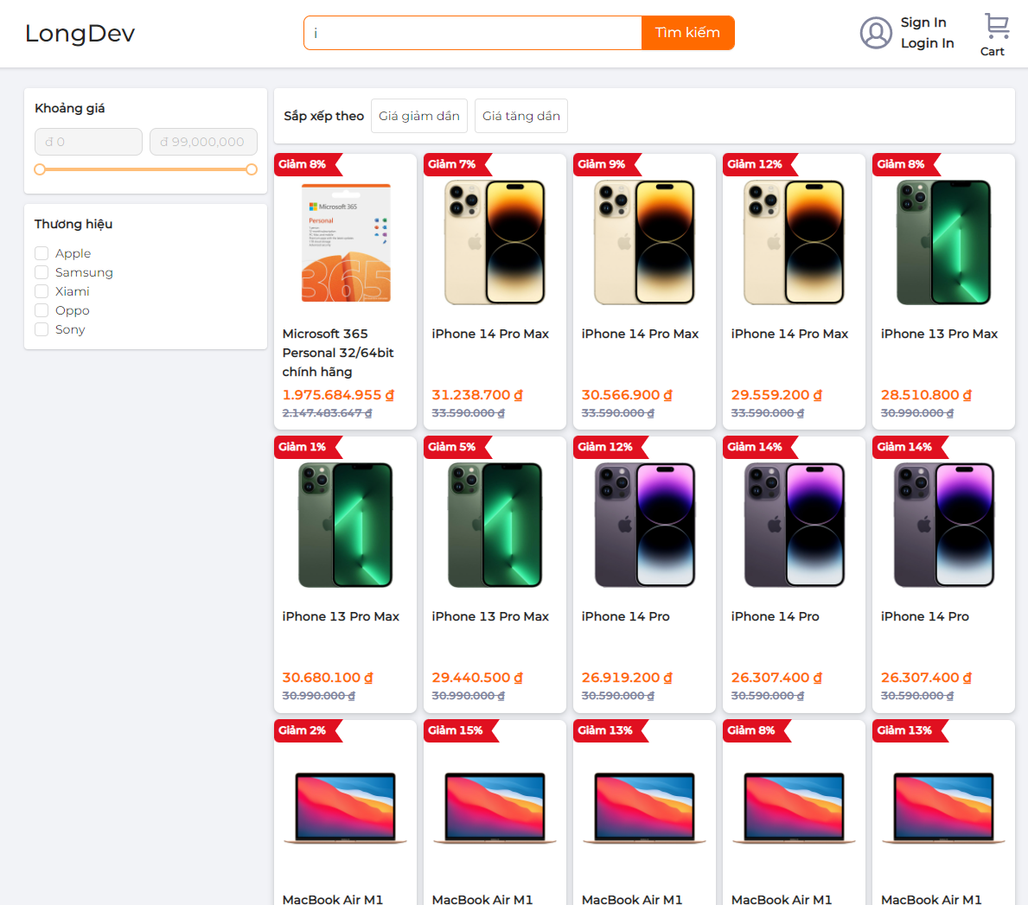
UI Design
Customer-side
The user selects the product he wants to buy:

Slide 20
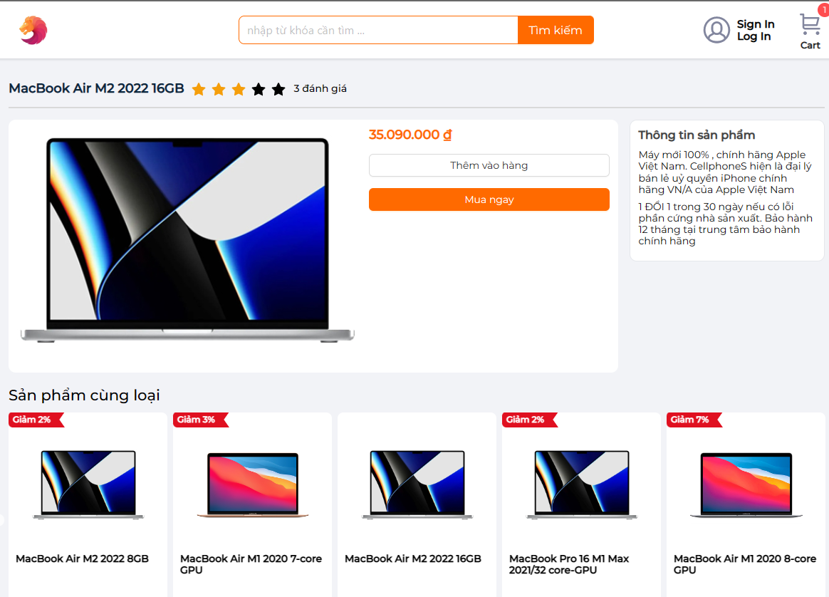
UI Design
Customer-side
Customer can view product detail

Slide 21
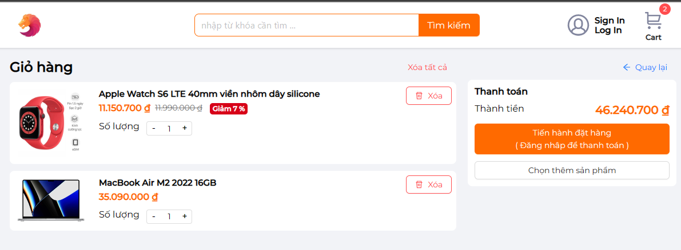
UI Design
Customer-side
Page cart:

Slide 22
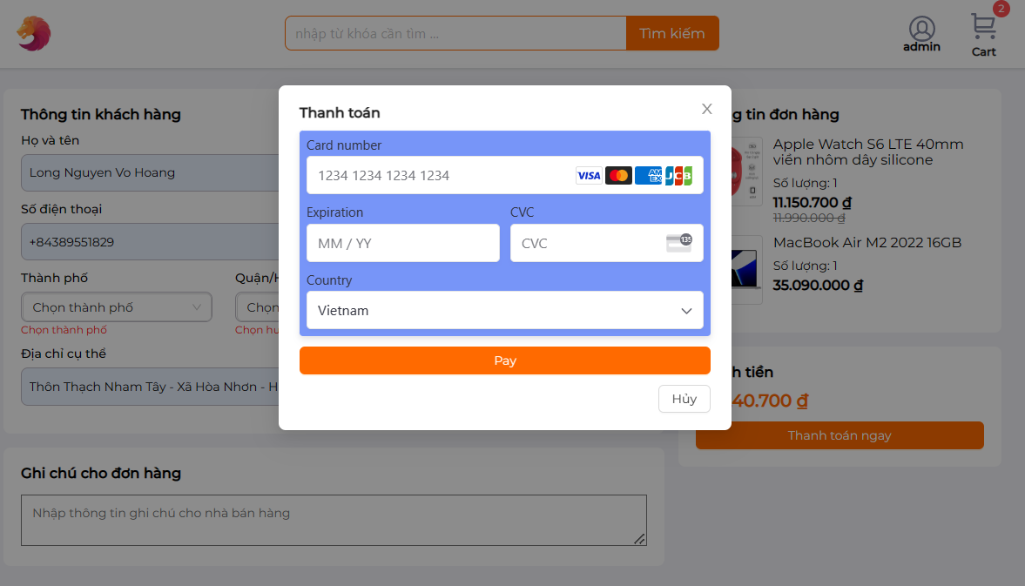
UI Design
Customer-side
Page checkout:

Slide 23
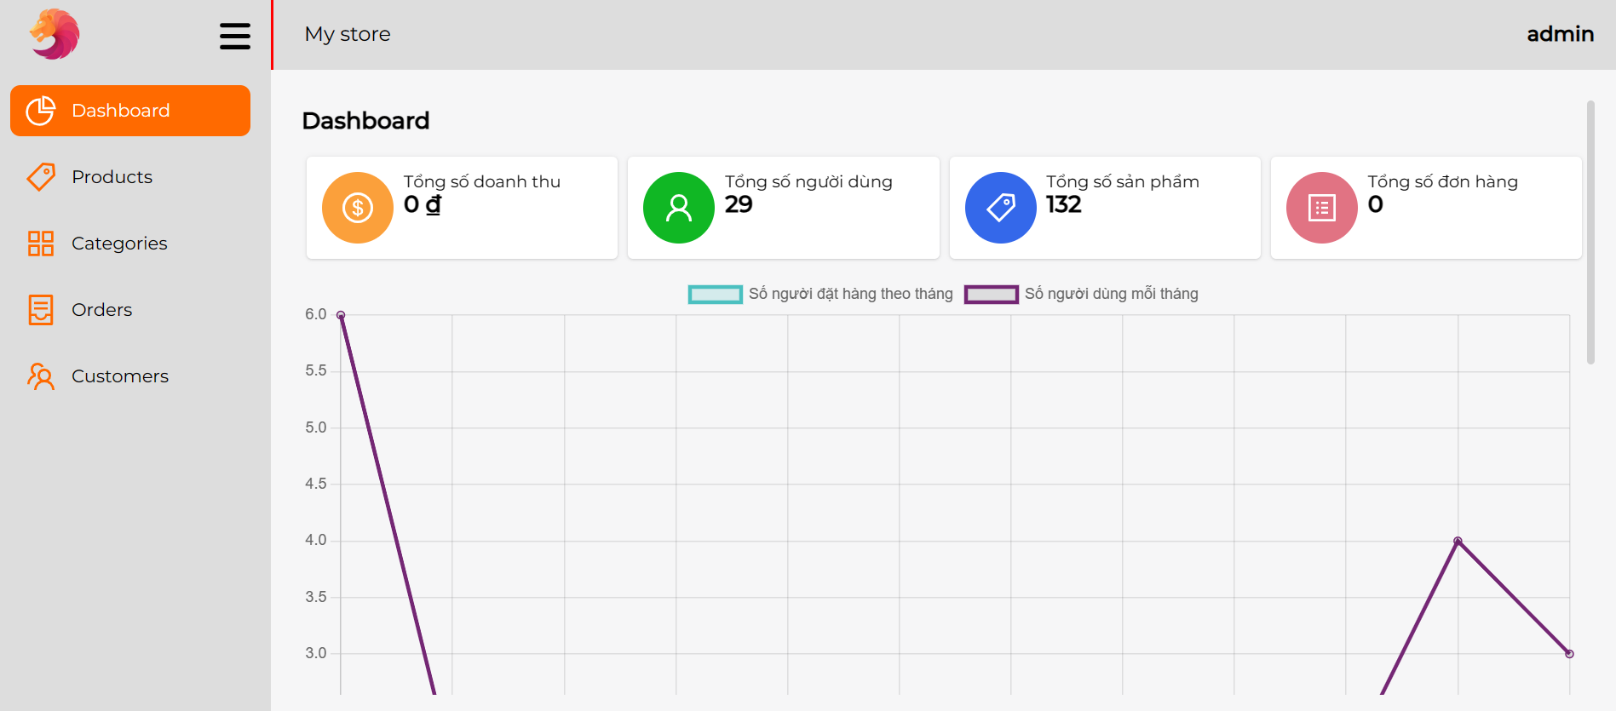
UI Design
Admin-side
Page admin:

Slide 24
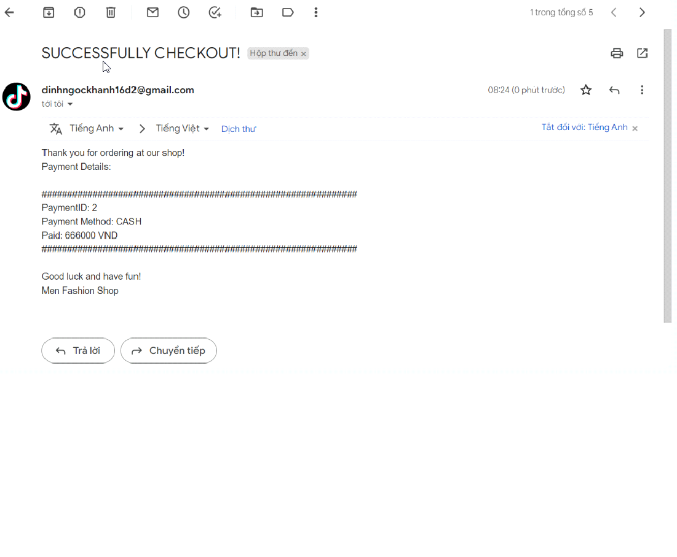
UI Design
Complete payment and purchase:

Slide 25
Thanks everyone for listening

